Slide 1
Soar Technology, Inc.

Slide 2



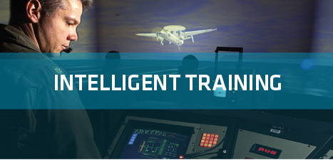
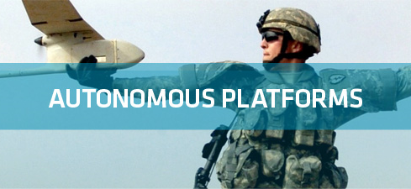
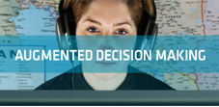
Soar Technology, Inc.
Spinoff of University of Michigan AI Lab (Soar Group)
R&D in Wide Array of Cognitive and Social Architecture Technologies
Market Segments
Full spectrum behavior models
Individually varied training
Mobile training
Control for Autonomous Platforms
Human-Robot Interfaces
Mixed Initiative Control
Intelligent User Interfaces
Behavior Modeling and Prediction
Reactive Planning
Focus Areas
MT-I (Army)
TigerBoard (Army)
SSIM (DARPA)
PercepTS (ONR)
RedRef (AFRL)
Helping our Heroes (OSD)
VESIP (Dept. of Ed)
Smart Interaction Devices (multiple)
SUMET (ONR)
LUCID (NAVAIR)
SAPIENT (CERDEC)
MAGIC (IRAD)
WEAVER (ONR)
SPRING (NSA)
SC2RAM (ONR)
C3E DUDE (IRAD)
Technology
Applications

Slide 3
Warfighter Problems
Intelligent Training
Unmanned Platforms
Data to Decisions

Slide 4
Technology Innovations
Autonomy
Adaptation
Human/System Interface

Slide 5
Warfighter Problems × Technology Innovations
Intelligent Training
Unmanned Platforms
Data to Decisions
Autonomy
Adaptation
Human/System Interface

Slide 6
Warfighter Problems × Technology Innovations
Intelligent Training
Unmanned Platforms
Data to Decisions
Full Spectrum Behavior Models
Autonomy Stack for UxVs
Automated Analysis of
Social Media
Autonomy
Individualized Varied Training
Interactive Task
Learning
Abductive Reasoning
Adaptation
Human/System Interface
Multimodal Student Sensing
Smart Interaction Devices
Adaptive User
Interfaces

Slide 7
Example Technology Lineage
Autonomy
Natural Interaction
Multi-Entity
Control
-30% error
rate over human
3x Mission Completion
1:100 operator: AC
ratio
AutoATC
SUMET
STOW97
Multi-Control
Recognize Pilot
Behaviors
Situational
Awareness
CogArch for Mission-Level Planning
TacAir-Soar (HBMs)
Multi-Modal Interaction
Train Pilots
Medibot
RedRef
Interactive Cultural Characters
Mixed-Mode
Interaction
PnPCAT
SID
Explain HBM Behavior
User-Assistive
Monitoring
76% workload
reduction
Mixed-Mode Dialogue
ECGF
Train ATCs
Tiger Board
Formative
Eval
CIANC
ROCCIE
ICF
HEAT
Winner
SAP
VISTA
2+D & Alerts
Task-Based
Alerts
Lucid
Generalize Multiple HBMs
Task-based Displays
Magic
2010
Sapient
BINAH
WEAVER
Context-aware Displays
Initial Fleet
Deployment
AIA
SoarTech
Founded
1992
…
1998
…
2000
2002
2004
2006
2008
2010
2012 …
Notes:
Magic Competition
Lucid
Sapient

Slide 8
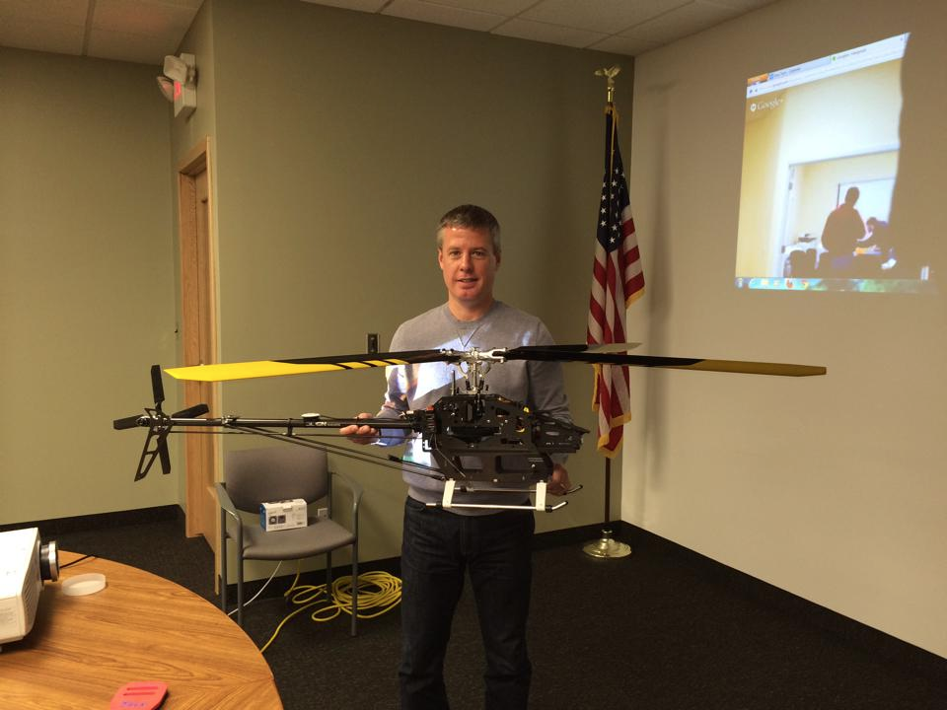
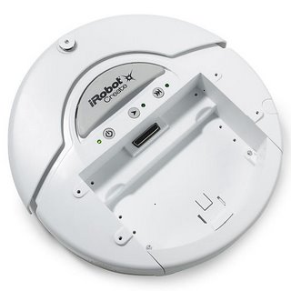
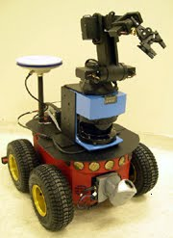
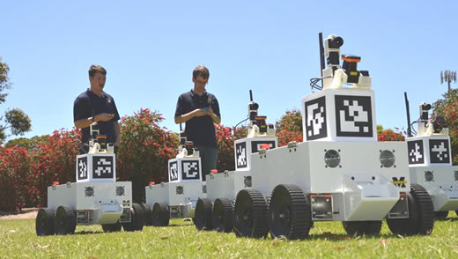
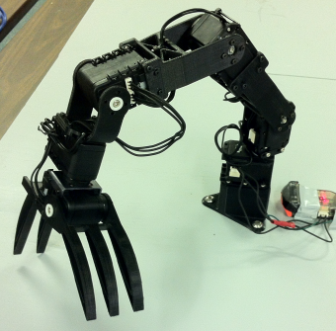
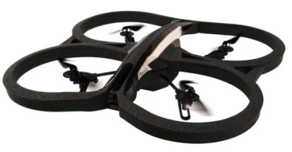
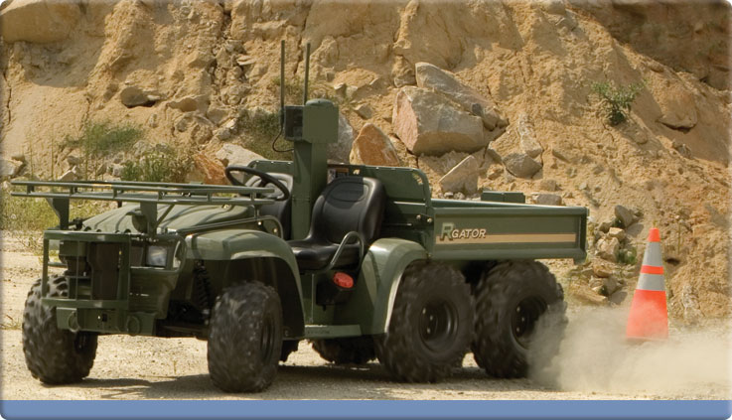
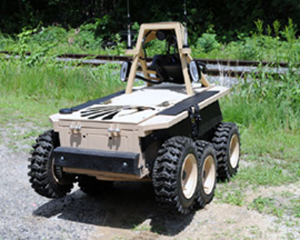
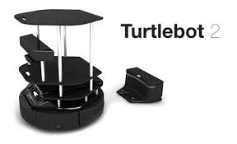
SoarTech’s Fleet of Robots

Slide 9
Contributions to the Soar community
jSoar
jSoar 0.14.0 released this morning
See Bob Marinier’s talk this morning
cSoar
Addition of multiple new features to cSoar 9.3.3
Math queries for semantic memory
TCL support
See Mazin’s talk this morning
See Alex’s talk tomorrow
Preliminary comparison of Soar to other modeling approaches
Used TankSoar as the task/domain
See Jacob’s talk on Friday
Lots of contributions to Soar infrastructure
SimRadio documentation
SimJr documetation
SoarIDE improvements??

Slide 10
Nuggets and Coal
Nuggets
Transition success with TigerBoard/ STEAM
Increased focus on Soar including Soar 9’s new features (eagerly awaiting SVS)
SoarTech contributing code to the cSoar release
Coal
A (hopefully brief) respite from our crazy-making rate of growth
Awaiting the return of business as usual within the DoD S&T community
Still a challenge to quantify the benefits of Soar

